Slide 1
HTTP Server
as we saw previously
parsing html manually is brutal
package net/http is here to make life easier

Slide 2
HTTP server
we can use package net/http
to create an HTTP server
(remember, it’s still on top of TCP)

Slide 3
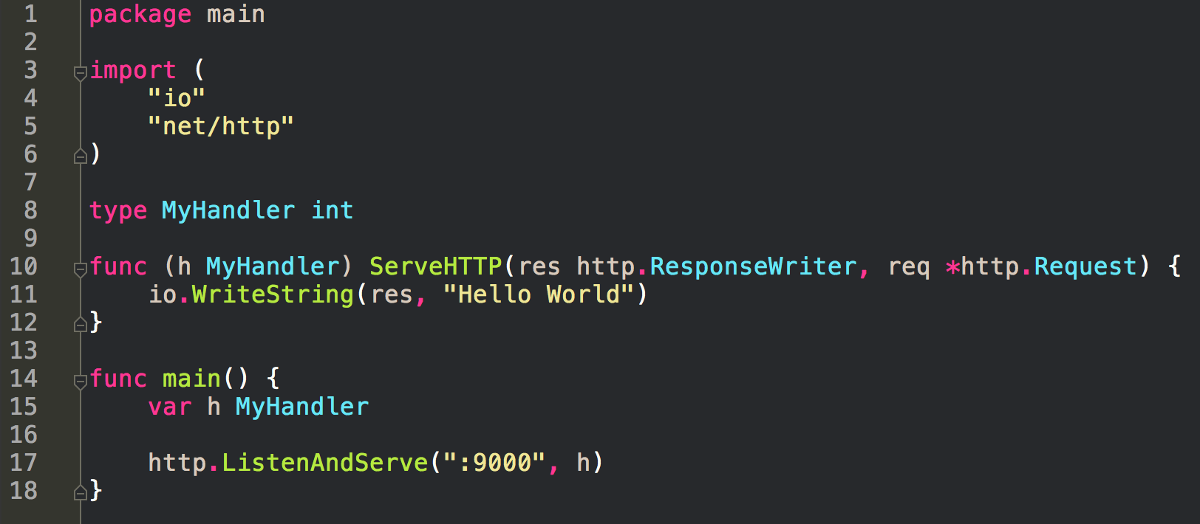
servers receive requests
and send back responses

Slide 4
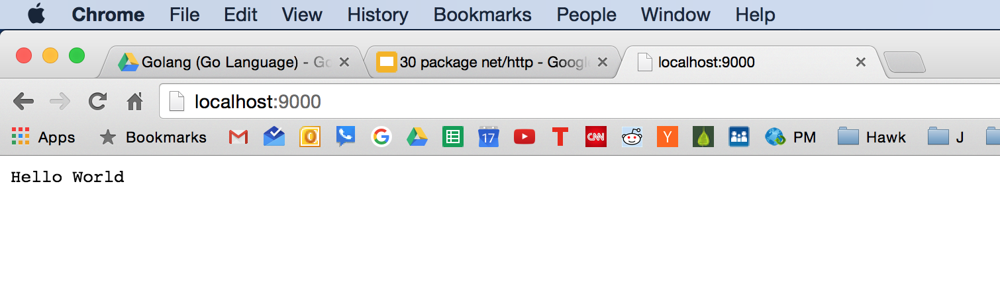
servers receive requests
and send back responses

Slide 5
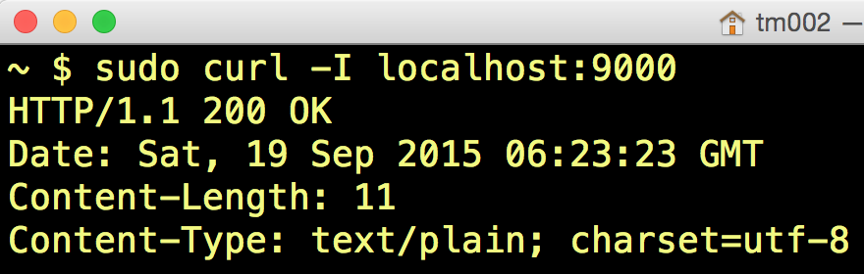
servers receive requests
and send back responses

Slide 6
servers receive requests
and send back responses
The variable h is of the type MyHandler. MyHandler is a user-defined type. The underlying type of MyHandler is an int. MyHandler has a method called ServeHTTP. Because MyHandler has the ServeHTTP method, MyHandler implements the handler interface. On line 17, http.ListenAndServe takes two arguments: the port on which it listens and a handler. If the second argument to ListenAndServe is nil, then the DefaultServeMux is used. Objects implementing the Handler interface can be registered to serve a particular path or subtree in the HTTP server. Handle registers the handler for the given pattern.

Slide 7
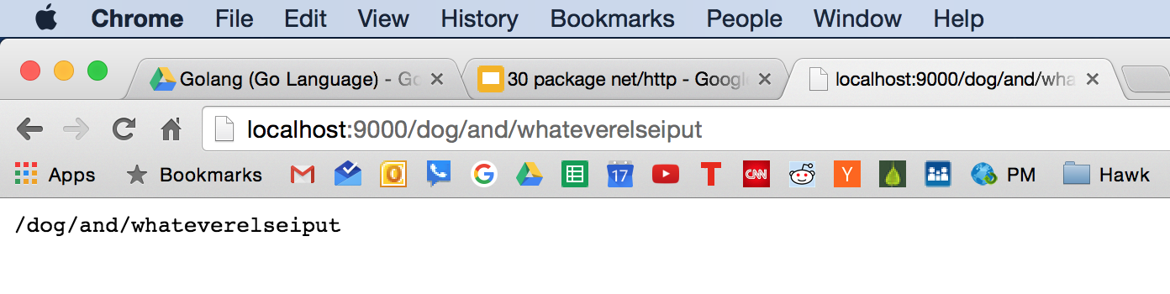
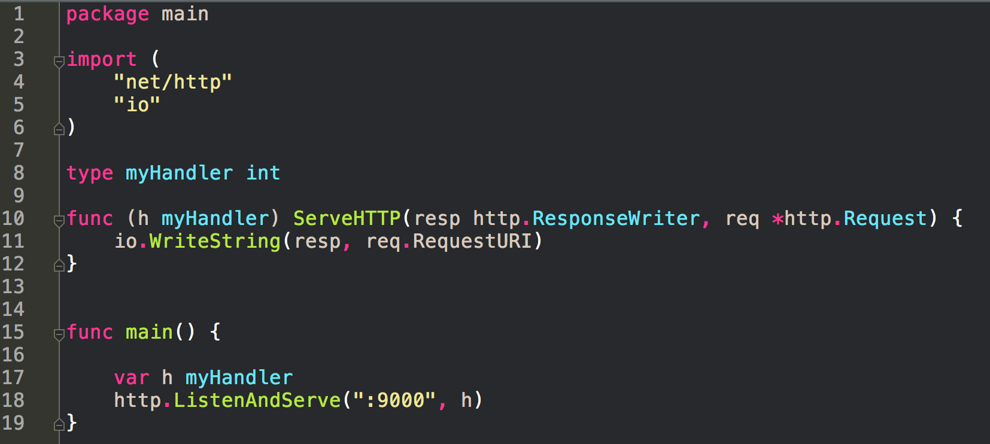

Slide 8
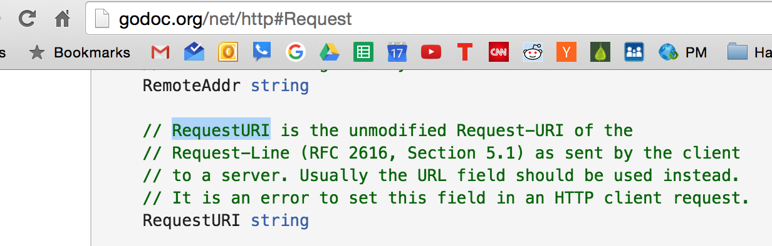

Slide 9
http://godoc.org/net/http#Request
look at the fields and methods for type Request

Slide 10
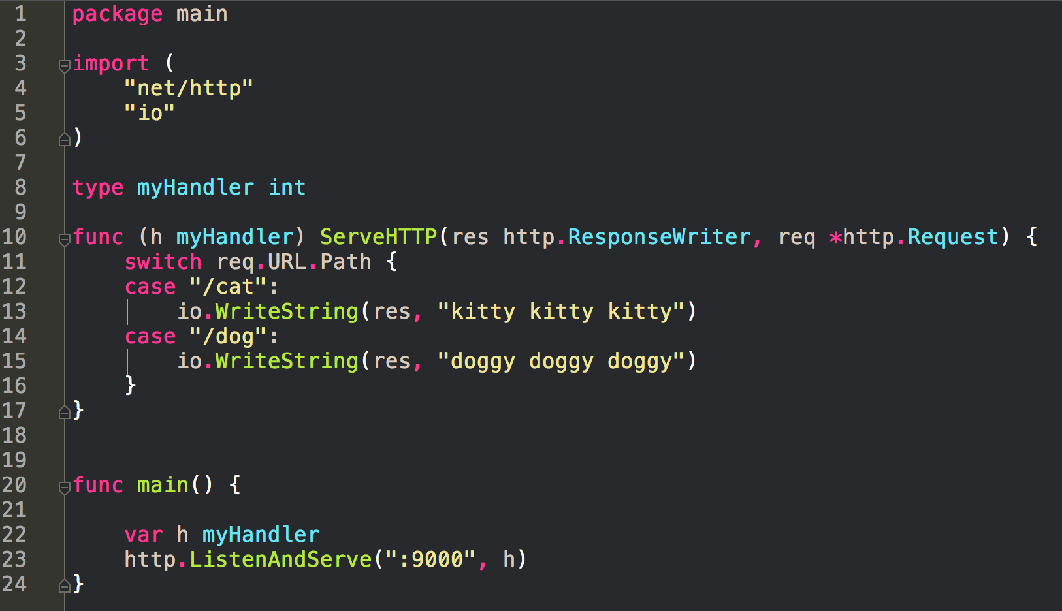
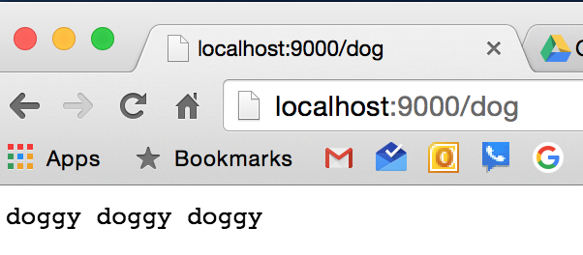

Slide 11
Important thing to keep in mind: there is no correspondence to the URL and anything on the computer -- not a file, not a path -- it’s whatever you want it to mean. The definition, the meaning of /cat or /dog is in the code. There is no “cat.php” or “dog.asp” file on my computer. Routing is completely defined by me.

Slide 12
Important thing to keep in mind: there is no correspondence to the URL and anything on the computer -- not a file, not a path -- it’s whatever you want it to mean. The definition, the meaning of /cat or /dog is in the code. There is no “cat.php” or “dog.asp” file on my computer. Routing is completely defined by me.
It’s up to you to define the meaning of your URLs

Slide 13
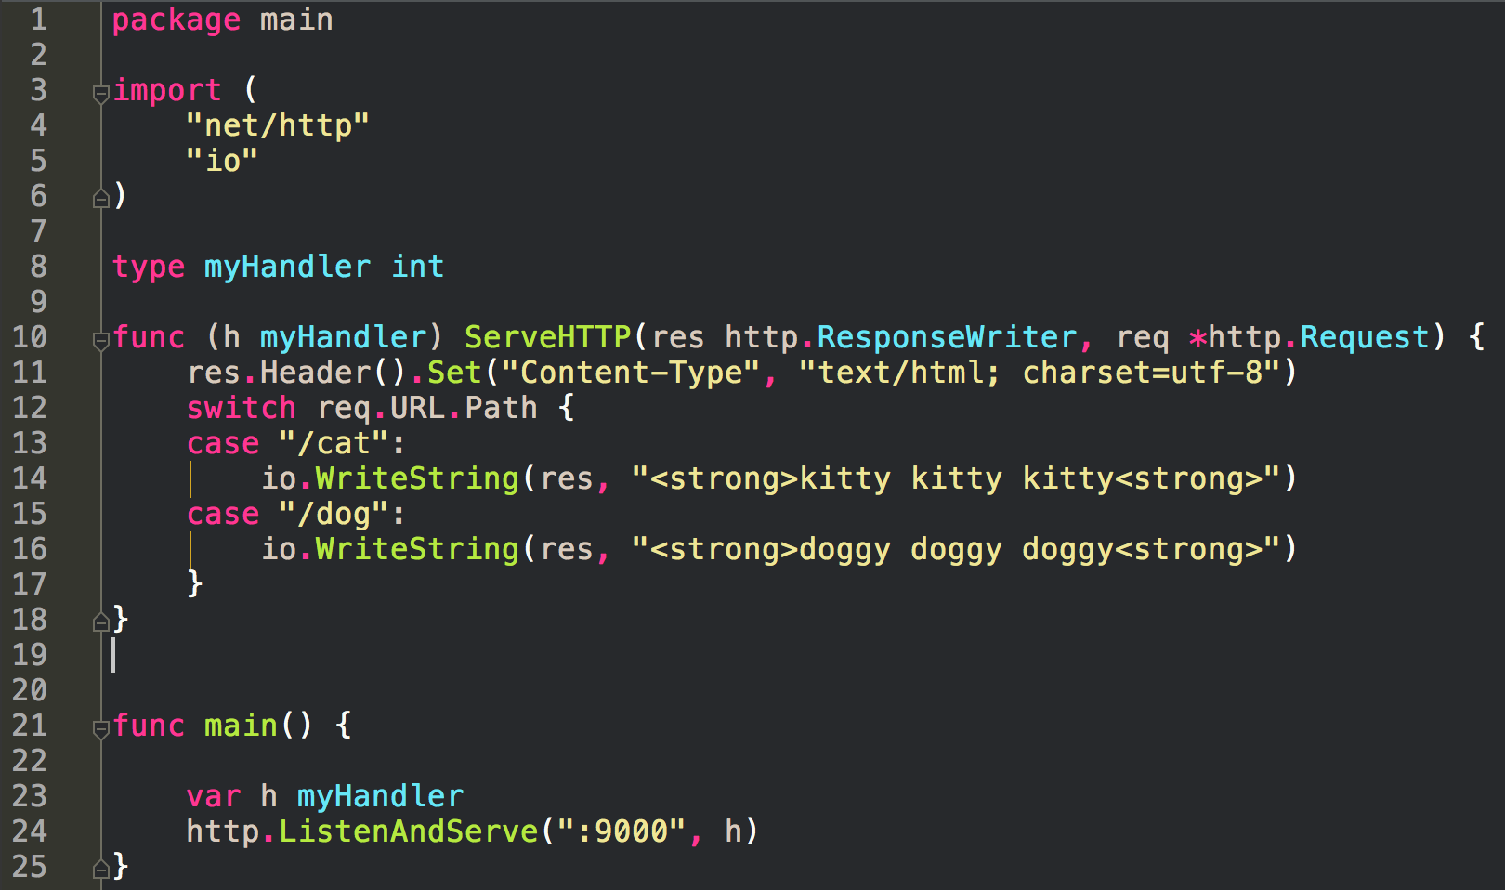
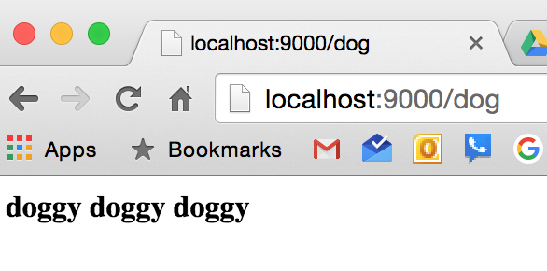

Slide 14
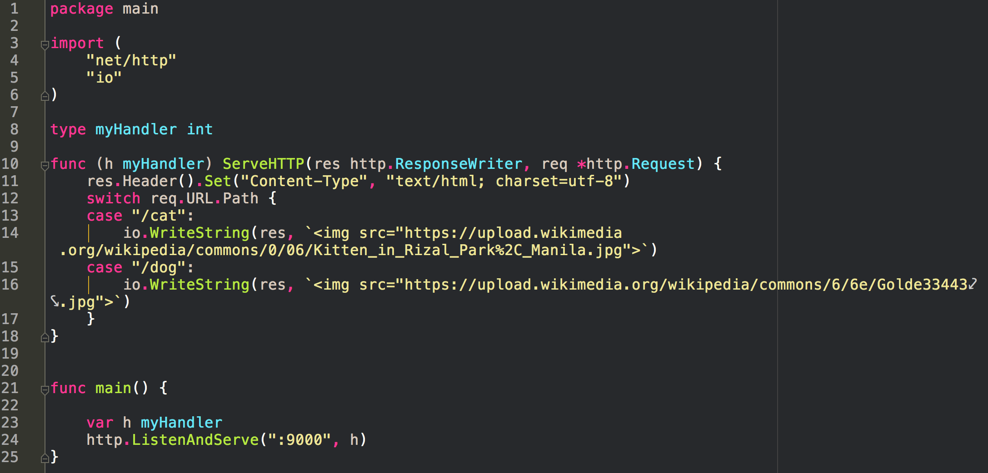

Slide 15
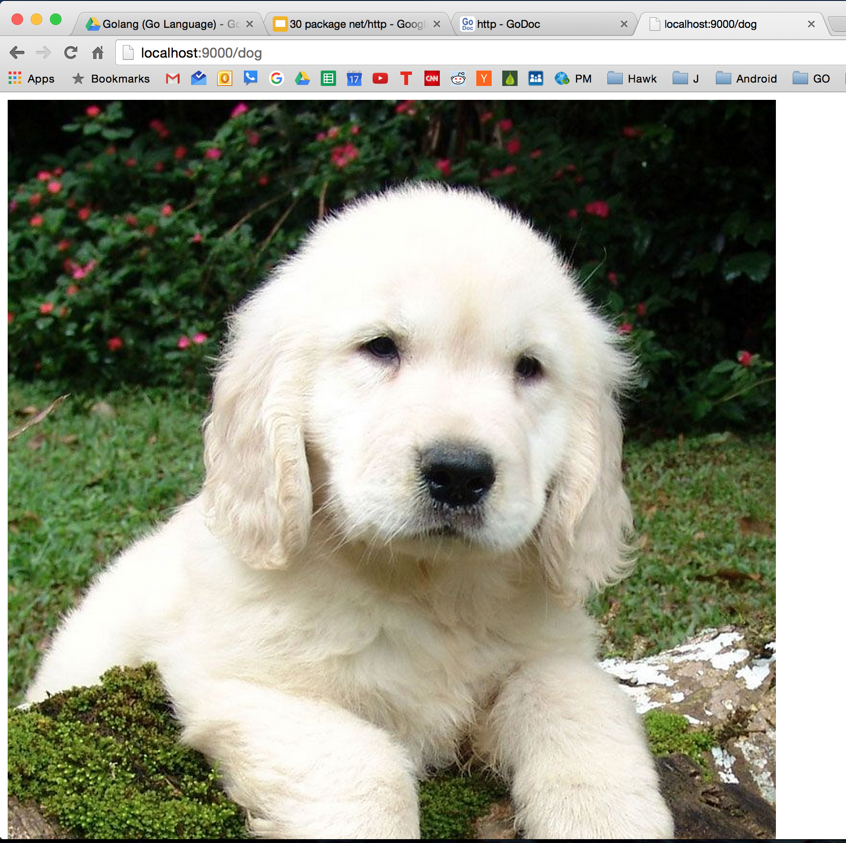

Slide 16
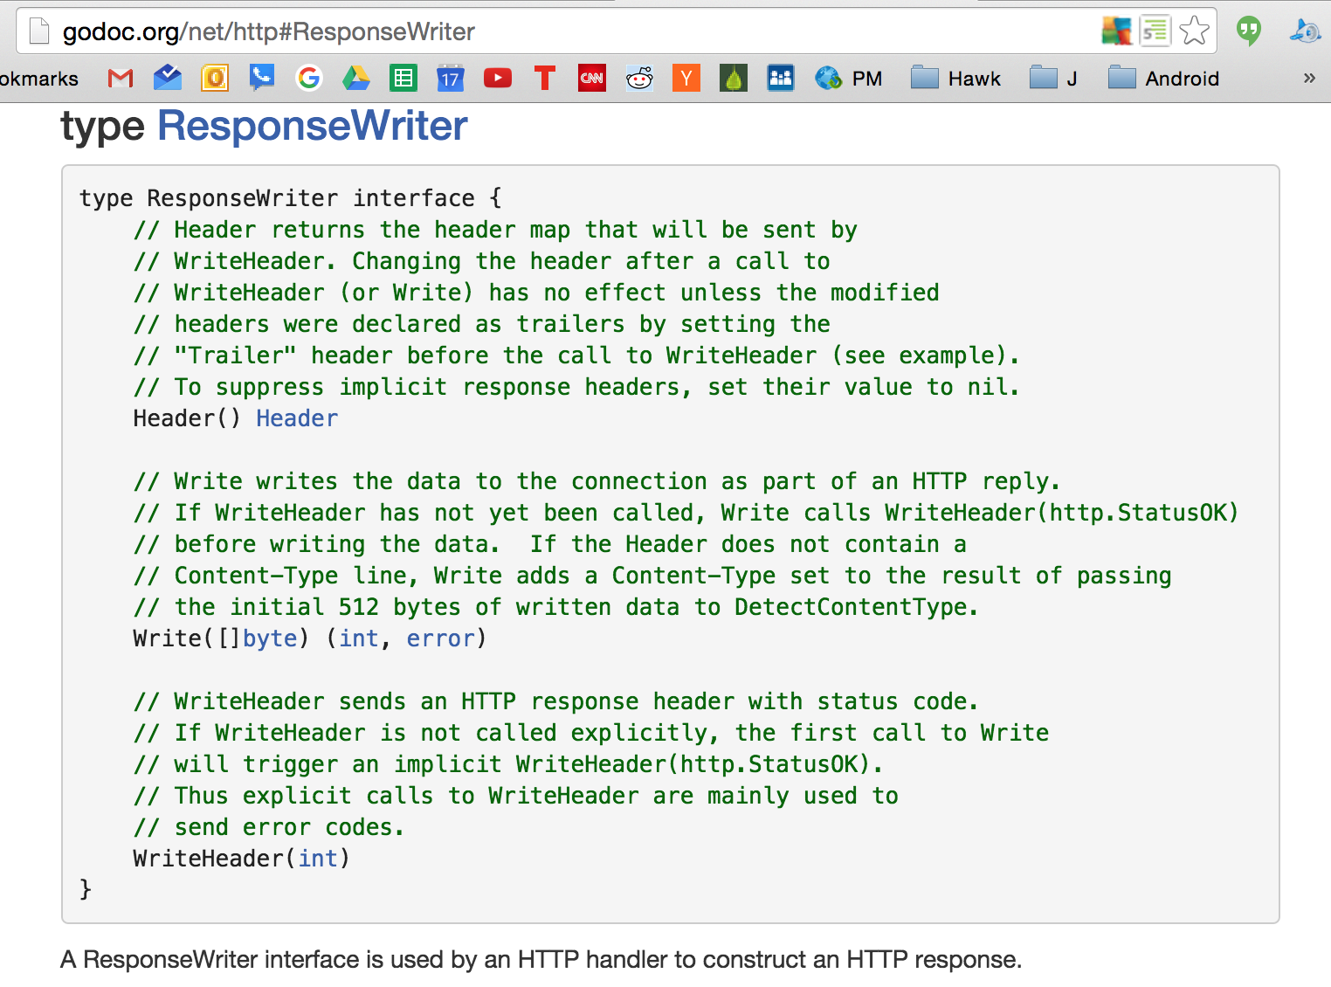
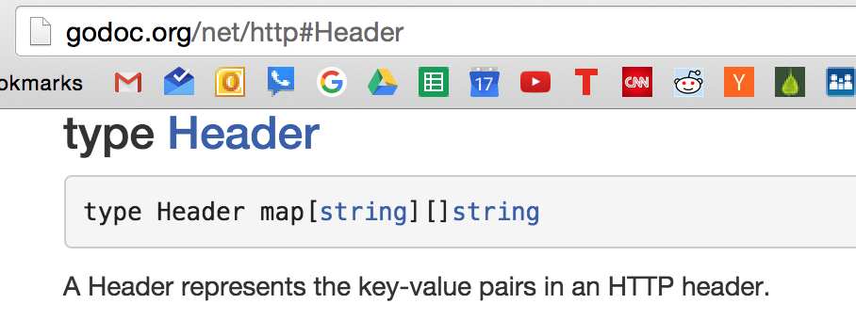
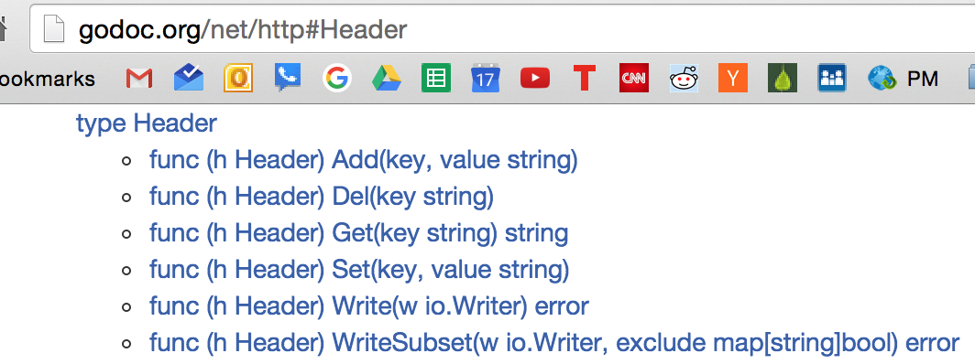
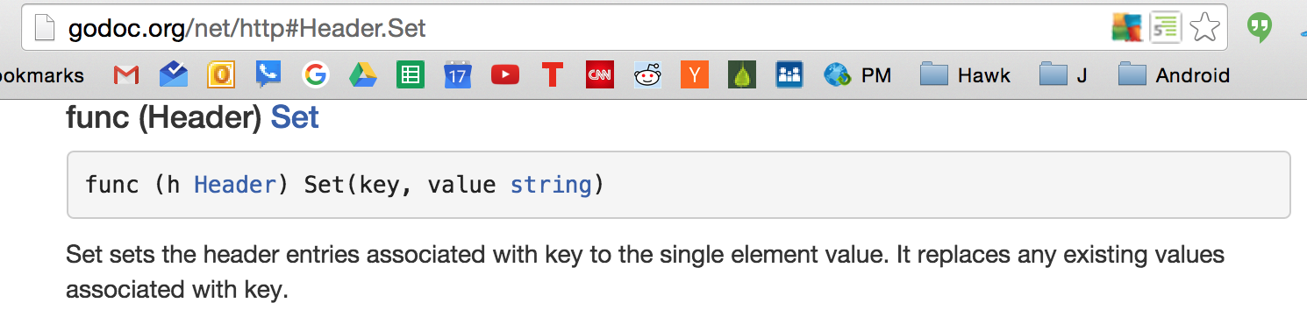

Slide 17
http://godoc.org/net/http#ResponseWriter
notice that ResponseWriter is an interface
whereas type Request was a struct

Slide 18
servers receive requests
and send back responses
Remember that it’s this simple

Slide 19
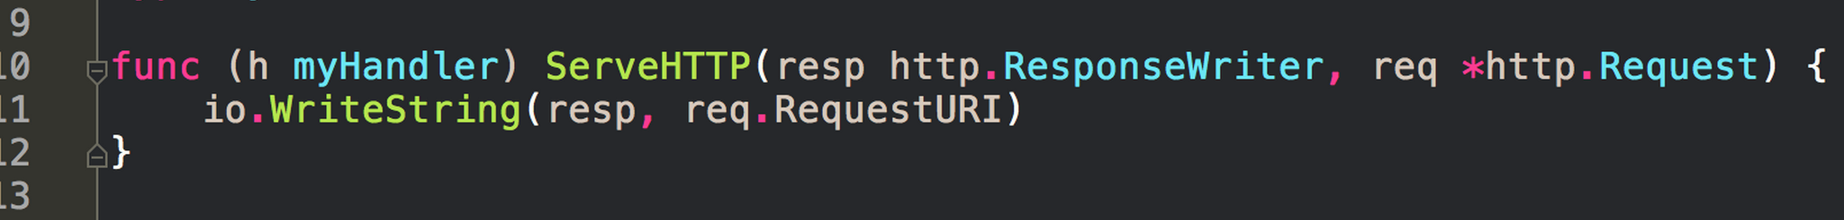
servers receive requests
and send back responses
Remember that it’s this simple

Slide 20
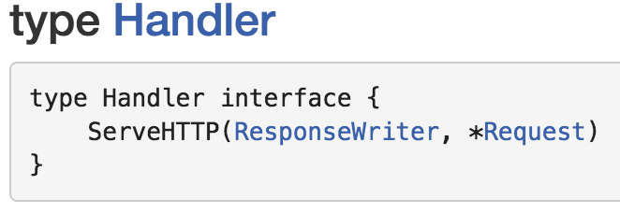
servers receive requests
and send back responses
Remember that it’s this simple

Slide 21
servers receive requests
and send back responses
Remember that it’s this simple

Slide 22
servers receive requests
and send back responses
Remember that it’s this simple

Slide 23
servers receive requests
and send back responses
Remember that it’s this simple

Slide 24
package net/http

Slide 25
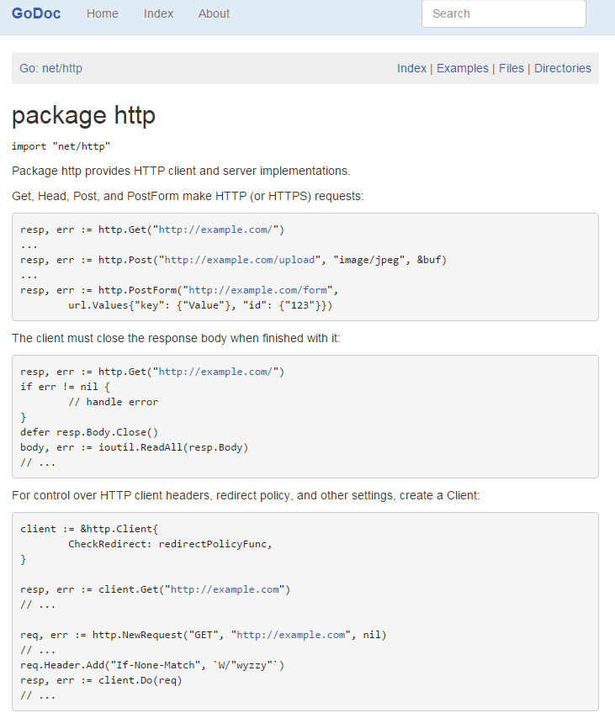

Slide 26
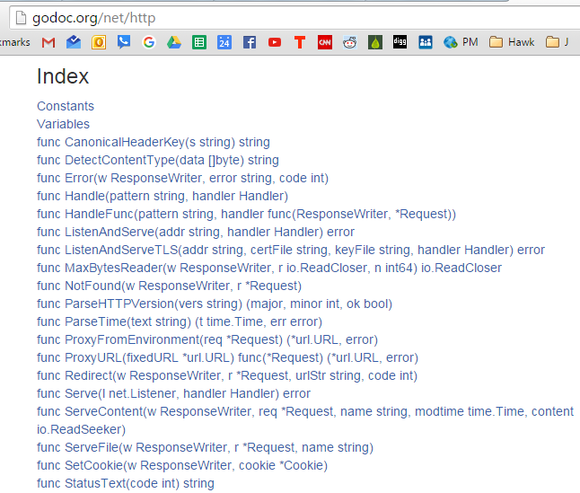
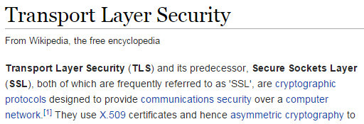

Slide 27
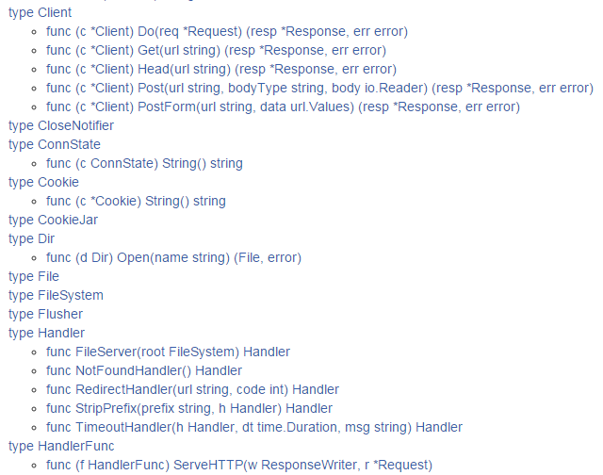

Slide 28
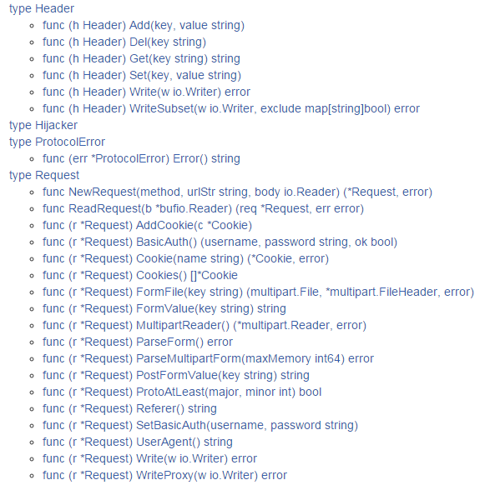

Slide 29
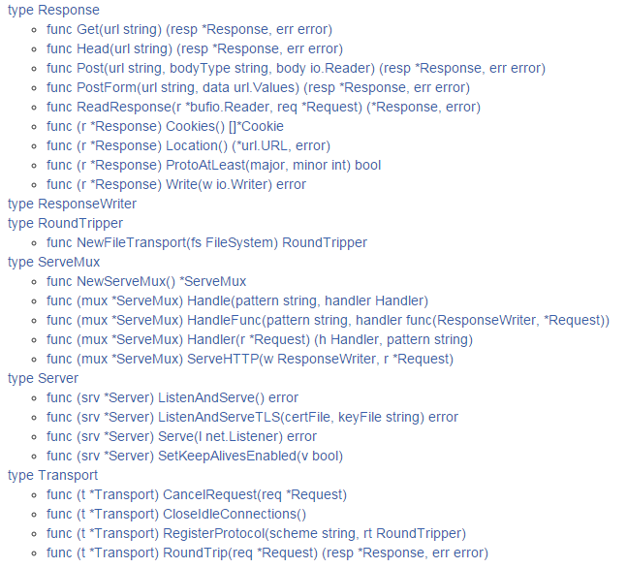

Slide 30
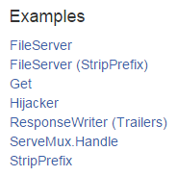

Slide 31
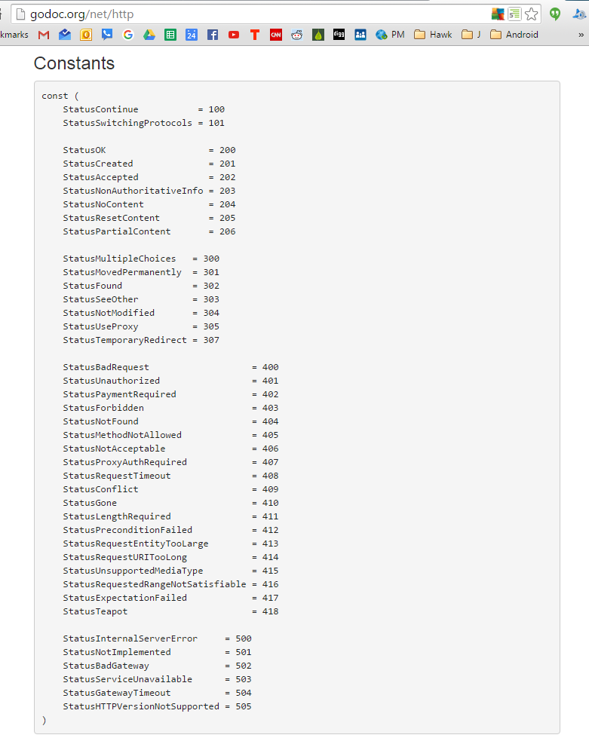

Slide 32
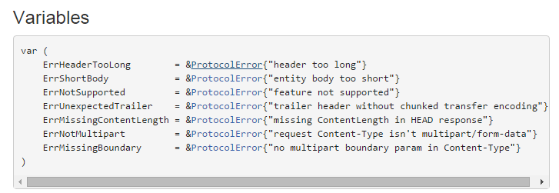

Slide 33
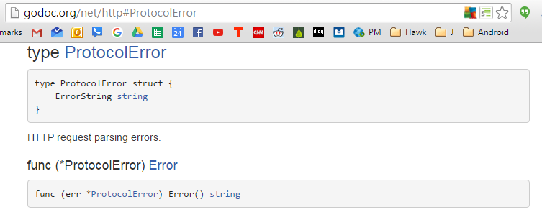

Slide 34
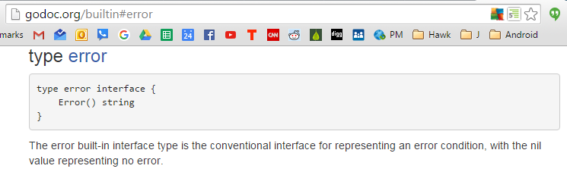

Slide 35
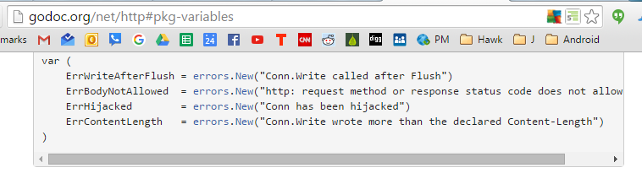

Slide 36
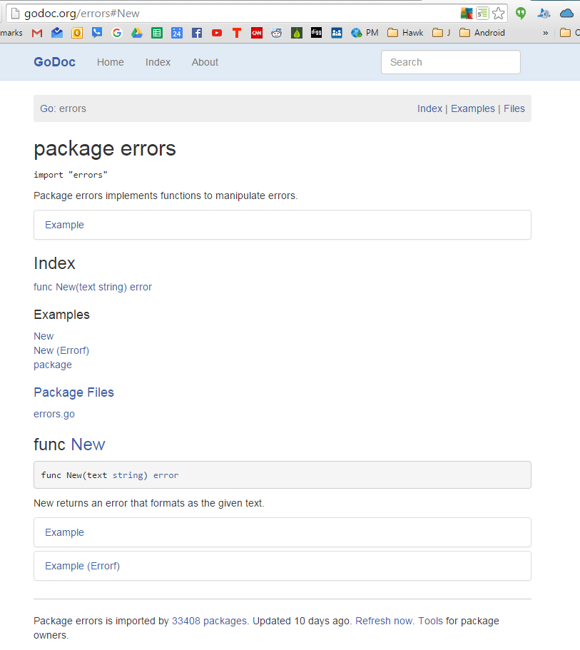

Slide 37
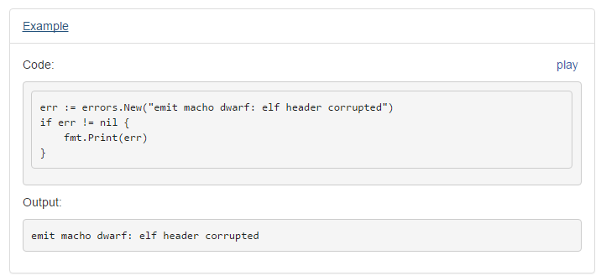

Slide 38
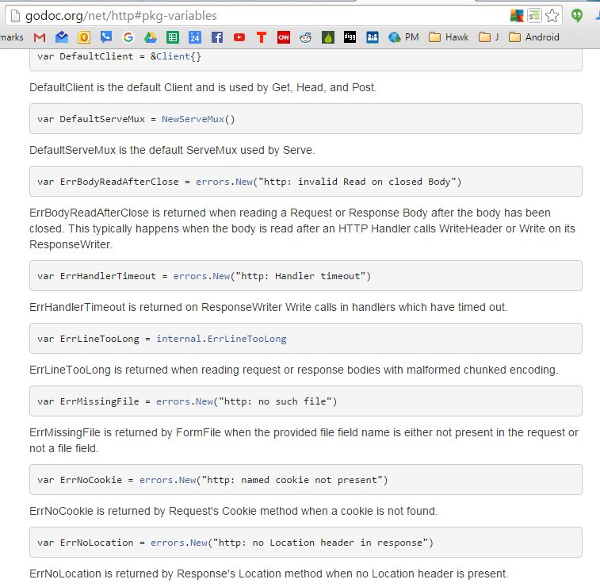

Slide 39
understanding our example

Slide 41
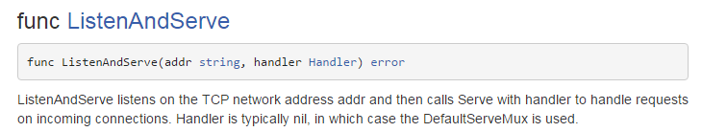
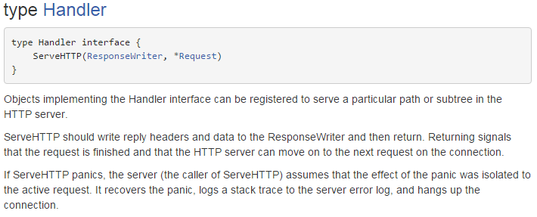

Slide 42
